Slide 1
Update on Michigan Student Growth Metrics
4/24/2026

Slide 2
Today’s Problem & Purpose
Michigan’s current growth model results in far more aggressive growth targets for high school students
Introduce possible modifications to make high school growth targets more equitable
Discuss current vs possible modifications

Slide 4
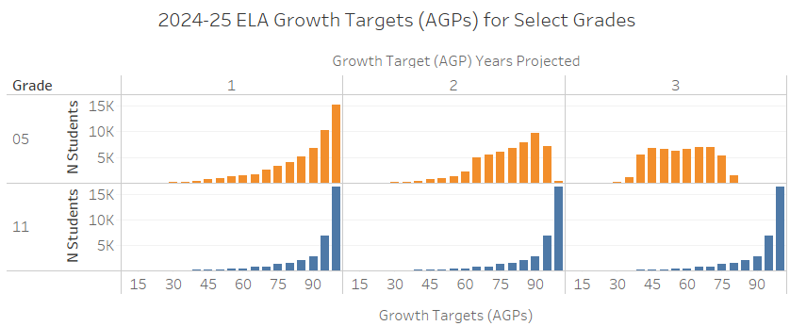
Copies of 1-year growth targets

Slide 5
Quick Refresher on Michigan’s Current Growth Model & Uses

Slide 6
State-Level Uses of Student Growth in Michigan
Public reporting
Parent Dashboard
Student Growth Report
Annual Education Report
High stakes school accountability
School Index
Notes:
Educator Evaluations were repealed from state law. Districts may now conduct those however based solely on local policy and do not report them to the state.
School grades were also repealed from state law.

Slide 7
Overview of Student Growth in Michigan
Growth Rationale
Support continuous improvement
Required by federal law (Every Student Succeeds Act; ESSA)
Growth Metrics
Growth Scores (Student Growth Percentile; SGP)
Growth Target (Adequate Growth Percentile; AGP)
Growth Areas
Content areas –Grades 4-8 & 11
(Grades 9 & 10 are given to schools in student datafile but not included in accountability)
Englisher language proficiency: Grades 1-12

Slide 8
Growth Metric Definitions
Growth Score (Student Growth Percentile; SGP)
The percent of students with similar score histories having lower growth than this student
Growth Target (Adequate Growth Percentile; AGP)
The growth score (SGP) which a student needs to consistently be at or above to reach proficiency within a set timeframe
Growth Target Timeframe
The number of years in which a student is expected to reach proficiency

Slide 9
Current Growth Target Methods
Quantile regression (R SGP Package)
Logistic Regression
Create student previous score history
Input previous scores into R SGP Package
Validate results
Apply the model
Build the model
Create historical longitudinal training dataset
Set norm group (assessment, content area, & prior1 PL)
Run logistic regression
Set growth target cutpoint at 50% probability of proficiency
Validate the results
Apply the model

Slide 10
Growth Target Methods by Assessment
Method | Assessment
Quantile regression (R SGP Package) | M-STEP, PSAT 8, PSAT 9, PSAT 10, & SAT WIDA Access
Logistic regression | MI-Access

Slide 11
Growth Target Method Precision
Method Name | Method Precision
Quantile regression (R SGP Package) | Individual student score history (student, assessment, content area, grade, prior1SS, & prior2SS)
Logistic regression | Group score history – handful of large buckets (assessment, content area, & prior1 performance level)

Slide 12
Growth Target Timeframes
In General | Content Areas | ELP
Michigan growth target timeframes are based on empirical review of past students’ progressions | Timeframes of 1-3 years 3-year max based on: Reliability concerns MI Legislature policy | Timeframes of 1-5 years 5-year max based on: Research (5-7 years) Federal policy

Slide 13
DRC Explorations

Slide 14
Data
Goal was to develop a model that could be applied to Grade 12 given a prior of grade 11
Data
Examined 3-year sequence from grades 9 to 11 for both Math and ELA
Restricted to using final SGPs; needs extended to scale scores.
Variables
Predictors: SGP 2024 and SGP 2025
Outcome: SGP 2025

Slide 15
Models
Variety of models and transformations
Linear
Polynomial
Quantile Regression
Including main (SGPs) and interaction effects
None of the model fit was good.

Slide 16
Next Steps/Considerations
None of this is great and we are looking for recommendations
Conditioning on Performance Level
Started this work, not too promising
Piece wising modeling
Consider between scale scores
Can we predict a pseudo grade 12 score?
Run SGPs?
Thoughts?

Slide 17
MDE Nearest Grade Average

Slide 18
Dusting Off Nearest Grade Average Method
Build the model
Create previous score history for nearest grade
ntile(50) the prior1 scores of nearest grade
Set norm group (assessment, content area, & prior1 ntile[50])
Calculate the average growth target (AGP) for each norm group
Validate the results
Apply the model
Allows all high school grades to project out up to 3 years (same as elementary/middle)
Used in 2018-19 for test transition to PSAT 8 and SAT
Slightly less precise than R SGP package but more precise than Logistic Regression method

Slide 19
Method Precision Revisited
Method Name | Method Precision
Quantile regression (R SGP Package) | Individual student score history (student, assessment, content area, grade, prior1SS, & prior2SS)
Nearest Grade Average | Group score history – many small buckets (assessment, content area, grade, & prior1 achievement ntile[50])
Logistic regression | Group score history – handful of large buckets (assessment, content area, & prior1 performance level)

Slide 20
Nearest Grade Average Changes Alignment Checks & Impact Evaluation
Alignment Checks
Impact Evaluation
Middle school grades
Content Areas – grades 7 & 8
WIDA Access – Grades 6, 7, 8
Compare R package & NGA AGPs
Impact – Students
Upper high school grades
Content Areas – grades 11
WIDA Access – Grades 10, 11, 12*
Compare R package & NGA AGPs
Impact – Students
Impact – Growth Component
Notes:
* By 2026-27 WIDA NGA AGPs would be applied to grades 8-12. However, we are choosing to limit to data post covid (i.e., 2021-22 and forward). Meaning as of 2024-25, the most we can project out is 3 years.

Slide 21
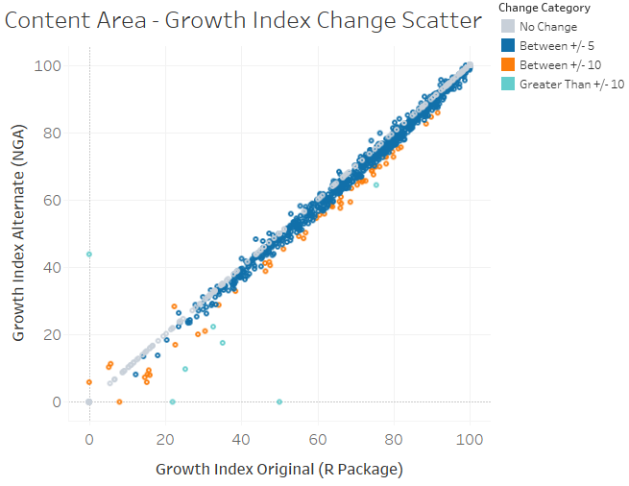
Content Areas Model Alignment Growth Index Scatter

Slide 22
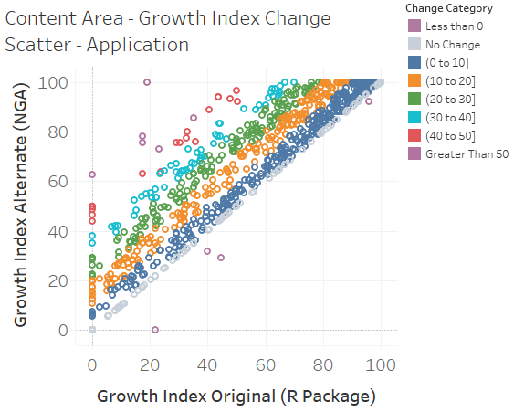
Content Area Model Application Growth Index Scatter

Slide 23
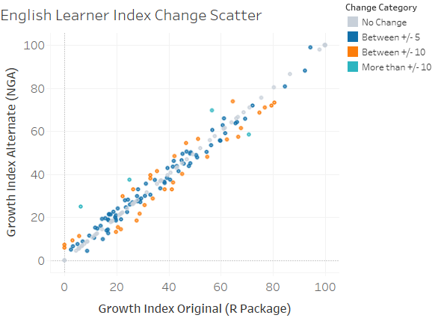
English Learner Model Alignment Growth Index Scatter

Slide 24
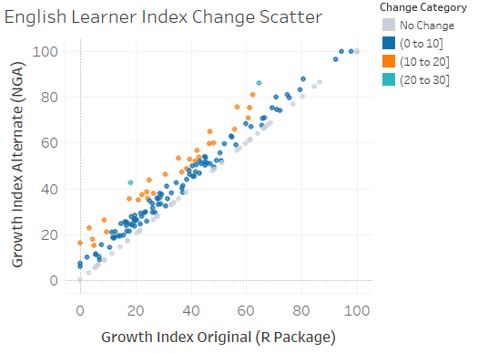
English Learner Model Application Growth Index Scatter

Slide 25
NGA Application Summary
Fairly tight alignment
More reasonable targets for both content areas and English Learners (EL)
Meaningful impacts on aggregate Growth and EL Progress index values
EL impact is expected to increase as we ramp up to 5-years post COVID

Slide 26
Discussion Questions
What concerns do you have with these methods?
Are there ways we could mitigate those concerns for these methods?
Ideas for other methods to extend years projected for high school grades? (Balancing complexity and the need for transparency and accessibility)

